Slide 1


Machine
Learning
Demystifying the World of Artificial Intelligence and Exploring Its Potential

Slide 2

Feature Selection & Dimensionality Reduction
dimensionality reduction provides higher model accuracy as it preserves more information about feature relationships.
Machine Learning

Slide 3
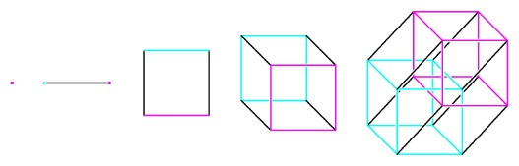
Dimension Reduction
Dimensionality reduction, or dimension reduction, is the transformation of data from a high-dimensional space into a low-dimensional space so that the low-dimensional representation retains some meaningful properties of the original data
Machine Learning

Slide 4
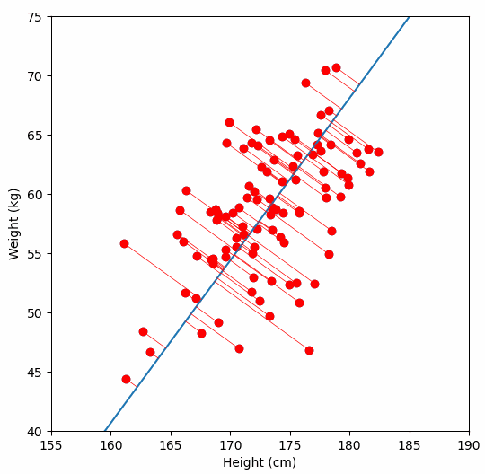
Principal Component Analysis (PCA)
Principal component analysis, or PCA, is a dimensionality reduction method that is often used to reduce the dimensionality of large data sets, by transforming a large set of variables into a smaller one that still contains most of the information in the large set.
Reducing the number of variables of a data set naturally comes at the expense of accuracy, but the trick in dimensionality reduction is to trade a little accuracy for simplicity.
Because smaller data sets are easier to explore and visualize and make analyzing data points much easier and faster for machine learning algorithms without extraneous variables to process.
Machine Learning

Slide 5
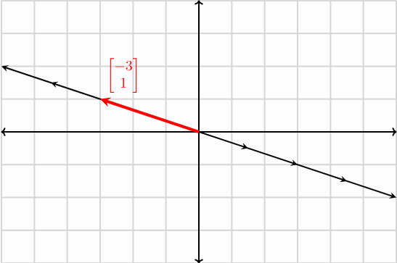
Principal Component Analysis (PCA)
What are Eigenvectors?
We know that vectors have both magnitude and direction when plotted on an XY (2-dim) plane.
When a vector is plotted, it’s direction is along its span. Now, there are some special vectors, which when transformed linearly, their directions don’t change, that is, they don’t get knocked off their span (the line passing through it’s origin and tip).
Machine Learning

Slide 6
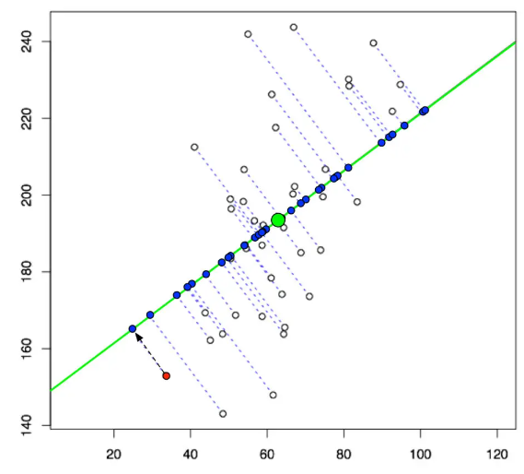
Principal Component Analysis (PCA)
Machine Learning

Slide 7
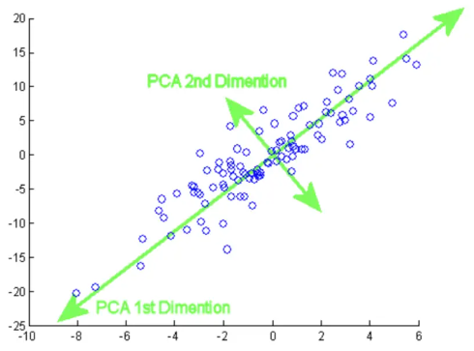
Principal Component Analysis (PCA)
Machine Learning

Slide 8
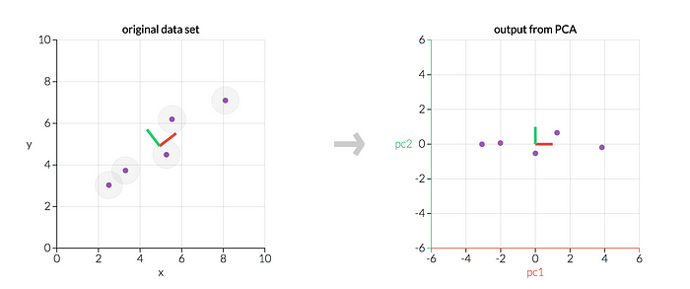
Principal Component Analysis (PCA)
Machine Learning
Notes:
Go to the code

Slide 9
Feature Selection
Information Gain: Information gain calculates the reduction in entropy from the transformation of a dataset. It can be used for feature selection by evaluating the Information gain of each variable in the context of the target variable.
Chi-square Test: The Chi-square test is used for categorical features in a dataset. We calculate Chi-square between each feature and the target and select the desired number of features with the best Chi-square scores. In order to correctly apply the chi-squared to test the relation between various features in the dataset and the target variable, the following conditions have to be met: the variables have to be categorical, sampled independently, and values should have an expected frequency greater than 5.
Fisher’s Score: Fisher score is one of the most widely used supervised feature selection methods. The algorithm we will use returns the ranks of the variables based on the fisher’s score in descending order. We can then select the variables as per the case.
Machine Learning

Slide 10
Feature Selection
Variance Threshold: The variance threshold is a simple baseline approach to feature selection. It removes all features whose variance doesn’t meet some threshold. By default, it removes all zero-variance features, i.e., features with the same value in all samples. We assume that features with a higher variance may contain more useful information but note that we are not taking the relationship between feature variables or feature and target variables into account.
The mean absolute difference (MAD) : computes the absolute difference from the mean value. The main difference between the variance and MAD measures is the absence of the square in the latter. The MAD, like the variance, is also a scaled variant.’ [1] This means that the higher the MAD, the higher the discriminatory power.
Machine Learning

Slide 11
THANK YOU!
Any Question!

